Slide 1


Digital Marketing Campaign Analysis
Evaluating campaign success through key performance metrics. Data-driven insights for optimized resource allocation and enhanced ROI.
by Navina Jolene

Slide 2
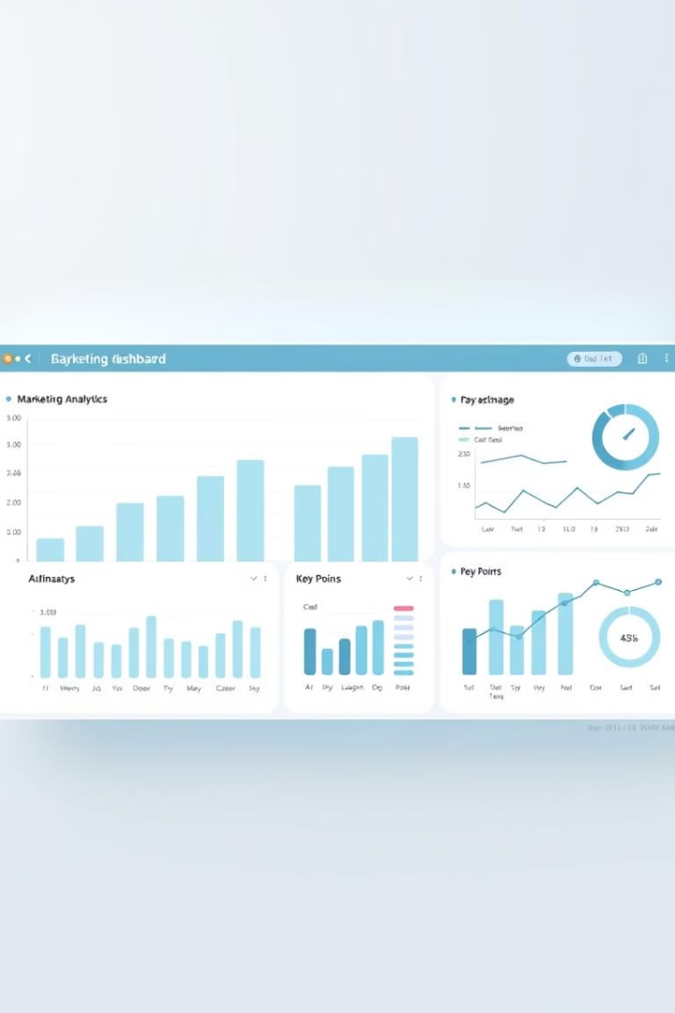
Project Overview
Objective
Key Focus
Assess digital campaign effectiveness.
Conversion rates, ROI, engagement.
Dataset
Multiple campaigns and platforms.

Slide 3
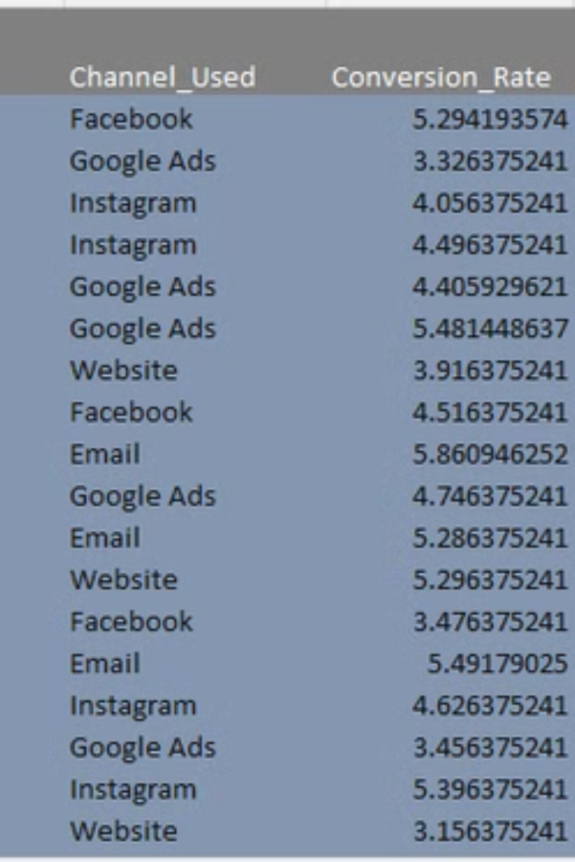
Dataset Overview
Source
Key Variables
Marketing campaign data from GitHub.
Campaign Type, Target Audience, ROI.
Time Frame
Multiple campaigns over periods.

Slide 4
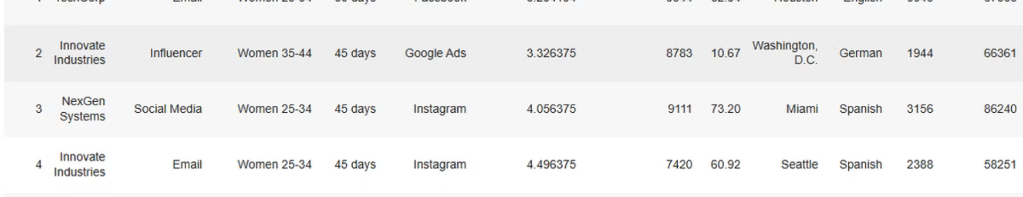


Data Exploration
Data Loading
Sample Preview
Pandas loads CSV files.
Quick data sample.

Slide 5
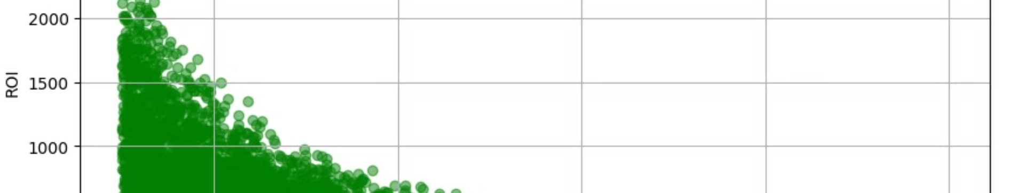



Descriptive Analysis
Statistics
Mean, median, std dev.
Conversion Rates
Acquisition cost distributions.
ROI Trends
ROI across campaigns.

Slide 6
Key Findings
Top Channels
Audience
Geography
Engagement
Highest ROI platforms
Best responding segments
Campaign success impact
Impressions, clicks, conversions

Slide 7
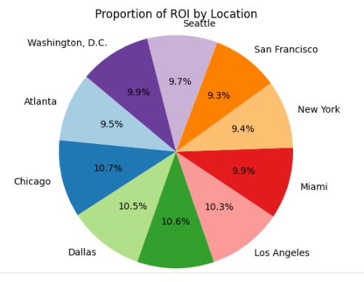



Visual Representations
2
Marketing Adjustments
Regional Effectiveness
1
3
Performance Metrics
Understand regional campaign effectiveness. Adjust marketing strategies based on geographical performance

Slide 8
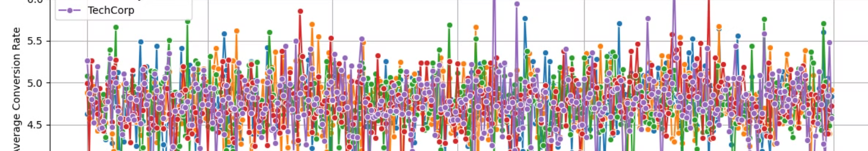
Performance Trends
Periodic Trends
Detect Spikes
Identify trends
Campaign effectiveness
1
2
3
Compare Performance
Multiple campaigns

Slide 9



Conclusion
Enhance ROI
1
Data-driven marketing.
Allocate Resources
2
Efficiently optimize.
Leverage Analytics
3
Improve performance.

